Slide 1
LENDING CLUB CASE STUDY

Slide 2
Problem Statement
This assignment aims to provide insights into how real-world business challenges are addressed through Exploratory Data Analysis (EDA). Specifically, it focuses on risk analytics within the banking and financial services sector, demonstrating how data analysis can mitigate the risk associated with lending.
Business Objectives
As the largest online loan marketplace, the company offers personal, business, and medical procedure financing with competitive interest rates and a user-friendly online interface. However, lending to "risky" applicants poses the greatest financial risk, known as credit loss, which occurs when borrowers default on their loans.
Identifying these risky loan applicants is crucial for reducing credit loss. The goal of this case study is to identify such applicants through EDA. By understanding the driving factors behind loan default, the company can enhance its portfolio management and risk assessment processes.

Slide 3
Business Understanding
You are employed by a consumer finance company specializing in providing various types of loans to urban customers. When evaluating loan applications, the company must make decisions based on the applicant's profile. There are two primary risks associated with these decisions
1) Loss of Business: If a potential borrower is likely to repay the loan but is denied approval, the company loses business opprtunities.
2) Financial Loss: If a borrower is unlikely to repay the loan, approving it may result in financial losses for the company.
The objective is to identify patterns indicating whether a person is likely to default on a loan. Understanding these patterns enables the company to take appropriate actions such as denying the loan, adjusting loan amounts, or offering loans at higher interest rates to risky applicants.
Loan Decision Scenarios
When a person applies for a loan, the company can take two types of decisions:
1) Loan Acceptance: If the company approves the loan, there are three possible outcomes:
Fully Paid: The applicant fully repays the loan amount (principal and interest).
Current: The applicant is in the process of repaying the loan and has not defaulted.
Charged-off: The applicant has defaulted by failing to repay instalments for an extended period.
2) Loan Rejection: The company rejects the loan application due to various reasons, resulting in no transactional history with those applicants.

Slide 4
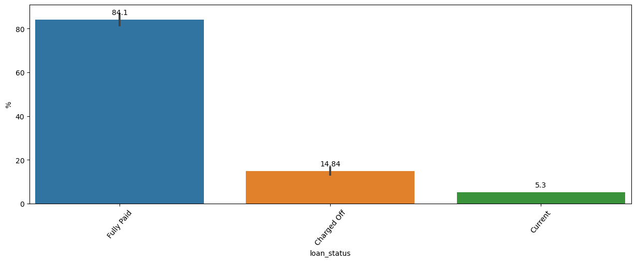
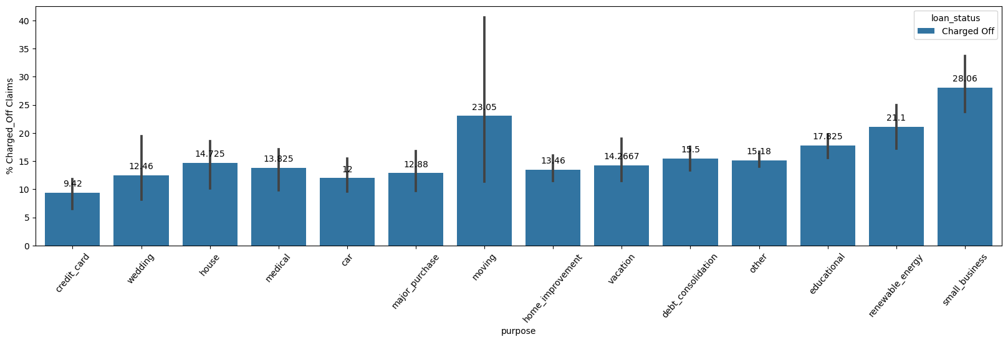
# Callouts focused on only Charged Accounts EDAs 1) 14% accounts are contributing as Charged Off accounts 2) Small Business, Moving, Renewable energy, educational purpose claims are contributing to around ~90% of the Charged off accounts. 3) Small Business pupose claims are contributing higher with 28.03% 4) On the Year on Year Claims, we could see a sharp decline in the small business & Renewable energy claims but more for the moving purposes by an increment of ~2-5%. Educational Claims are not having any trend or seasonality.

Slide 5
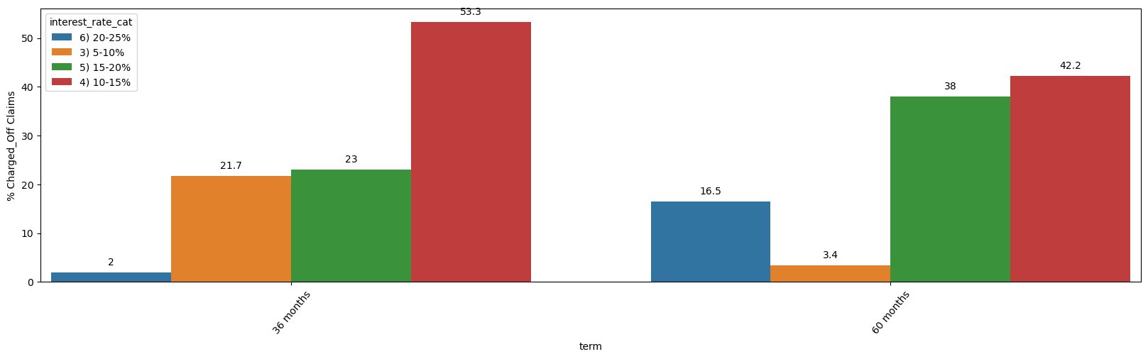
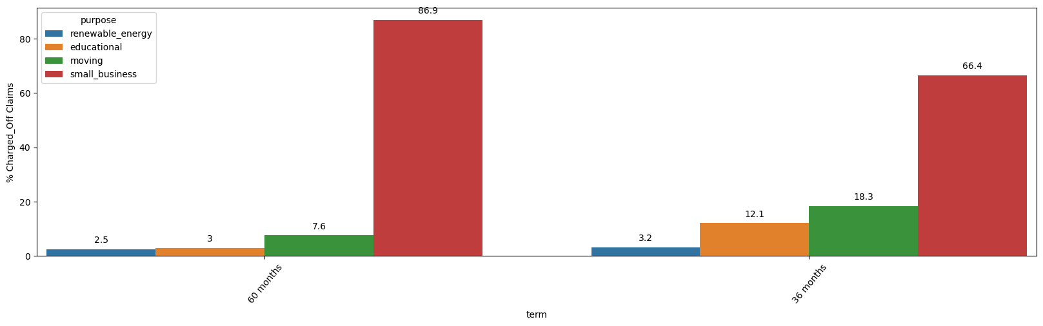
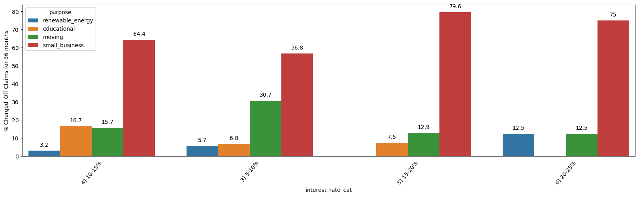
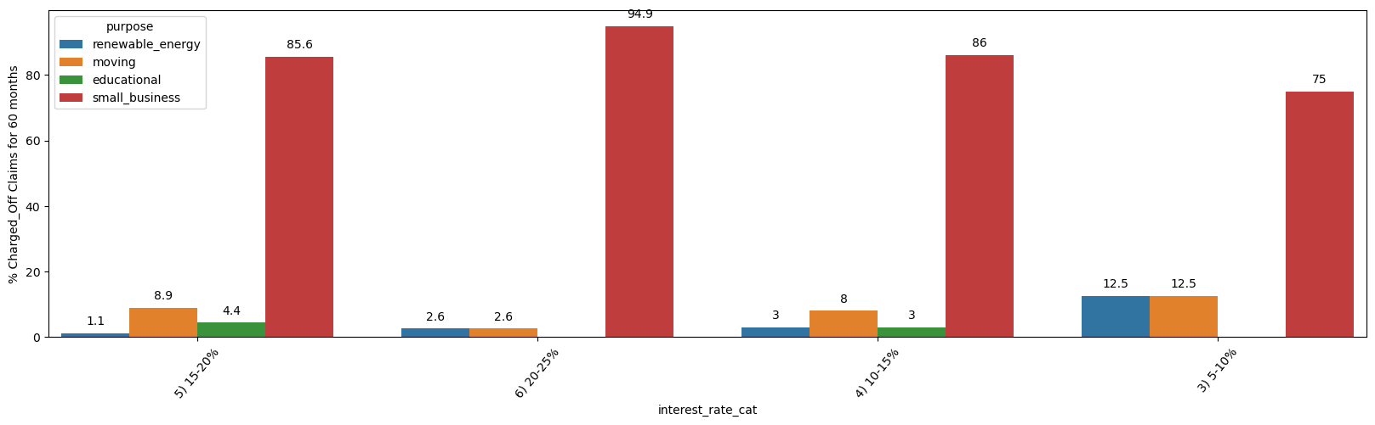
# Focusing only Charged Off accounts for Small Business, Moving, Renewable Energy & Educational Purposes data for L2 analysis since these are contributing to 90% of the charged off accounts. 1) Percentage of defaulters are more for 60 months terms. 2) In both terms 36 & 60 months, 10-15% Interest Buckets are highly to default by 56.98% & 46.75% 3) On those who takes 36 months term based loans, 10-15% & 5-10% Buckets contribute around 80% of the defaulters. 4) Where as in 60 months tenure, 10-15% & 15-20% Buckets contribute around 80% of the defaulters. 5) Small Business & Educational purpose contribute 90% of claims for 36 & 60 months terms. 6) In 36 months, Small Business contribute an average of 67% Claims across all the interest buckets where 15-20% interest bucket contributes the highest with ~80%. 7) In 60 months small business contribute an average of 80% having 20-25% with the highest with 95%.

Slide 6
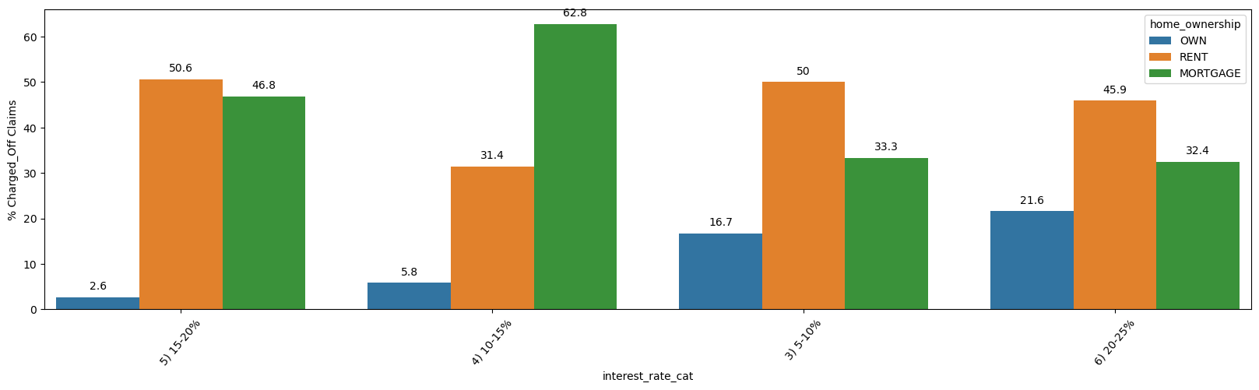
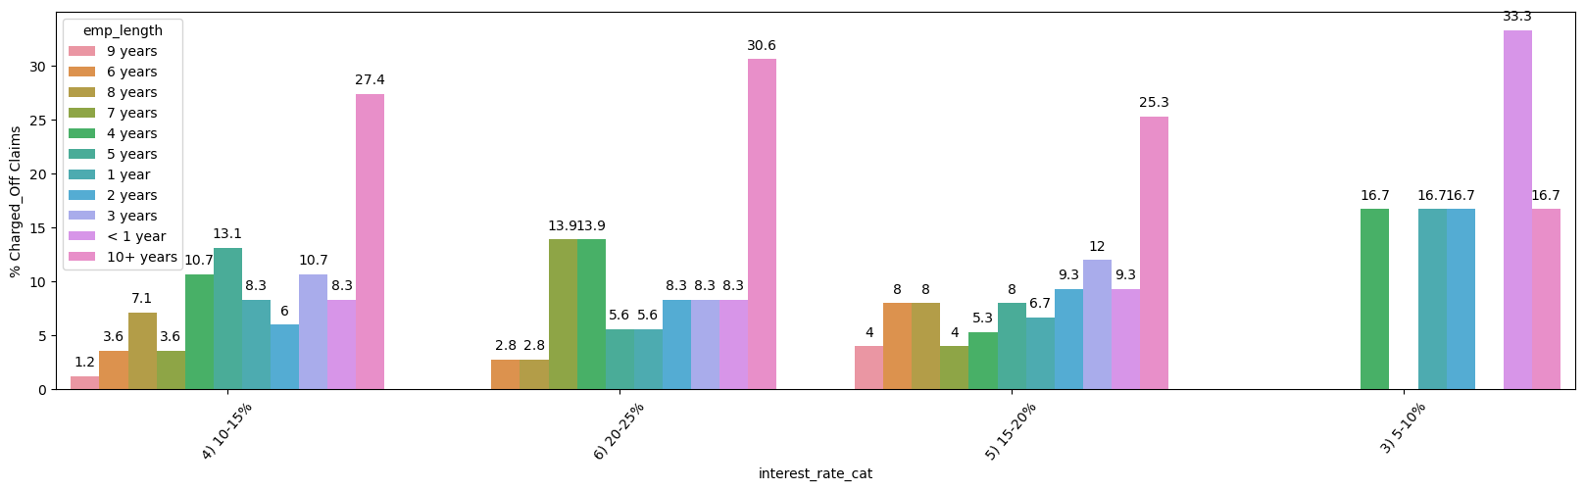
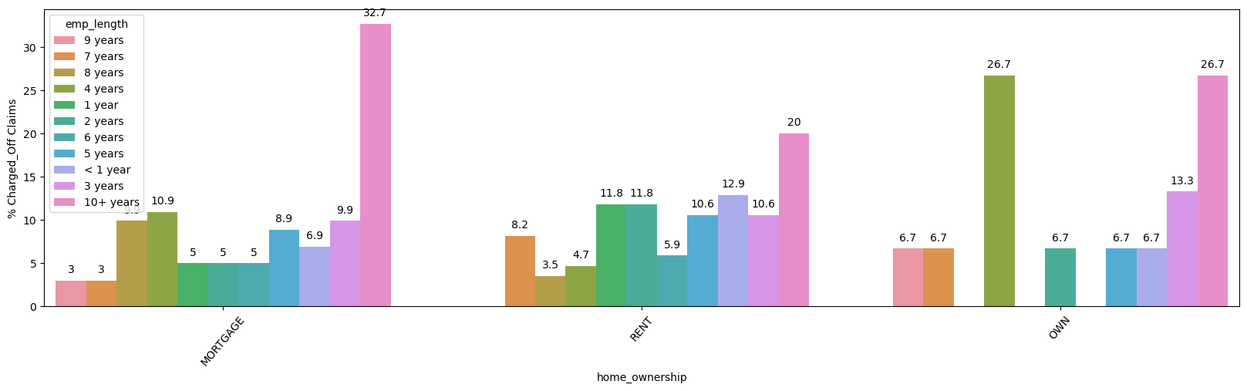
# Limiting the analysis by Focusing More on "Small business" purposes for "60 month" terms Major takeaway is on Small Business for 60 months tenure is : 1) People staying on Rent having employee experience of over 10+ are more prone to default..

Slide 7
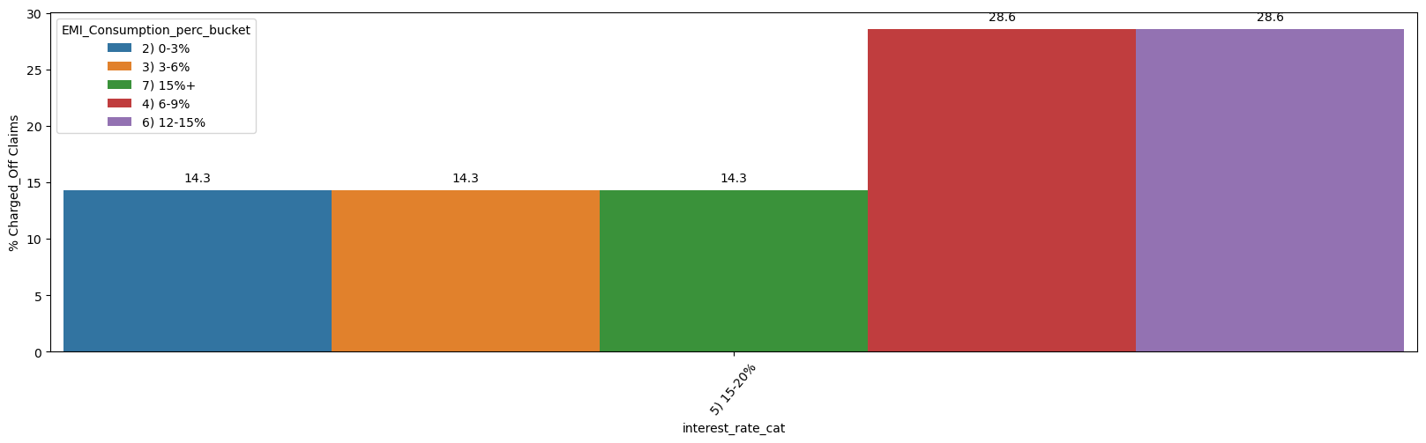
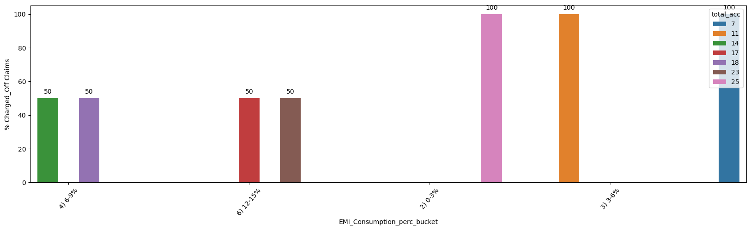
# Drill down more on homeownership "RENT" & With Emp_lenght = "10+" for "Small business" purposes for "60 month" terms and for '15-20%' Interest Buckets for revelancy New defining metri has been create for defining loan_amount + installment + salary (Combined) EMI_Consumption_perc = (installment*12) / annual_inc * 100 1) Those customers having an annual EMI Consumption of 6-9% & 12-15% contributes comsumption of average ~28% are more prone to default based on the annual salary. 2) Among 6-9% & 12-15% annual EMI consumption, Those who has account over 14, are the defaulters. Major Driver variables : id, int_rate, installment, emp_length, home_ownership, annual_inc, issue_d, loan_status, year

